Slide 1

QER- 4912
QER: BID 141KM SF300065C004.5X – Weld crack at Zeta wire

Slide 2
Pipe section / Details
Item | Traceability / identification
Project number | SF300065C004
Project name | BID 141KM
Pipe section | SF300065C004.10X
ST number | ST101.51896
Affected layer / equipment | Inner carcass
Length affected | 1. 2731.6m 2. 3649.5m 3. 3725.6m 4. 3801.7m 5. 3952m 6. 4435.5m
Drawing number / MP code / STA / Dimension | : 40mm x 0.8mm Stainless steel strip FE 04 DUPLEX (MP460)

Slide 3
Overview of anomaly
Problem Description :-
During the zeta spiraling process for BID 141KM SF300065C004.5X (ST10151896), the weld cracks were detected at lengths 277.7m during weld inspection after it was laid on the pipe.
Details of the defective weld are as the following: -
1. Length on the pipe: 277.7m
Weld No: 01-15
Bobbin no: 003
2. Length on the pipe: 620.3m
Weld No: 08-08 (Joint bobbin weld)
Bobbin no: 013
3. Length on the pipe: 1378.4m
Weld No: 11-15
Bobbin no: 016
4. Length on the pipe: 2619.8m
Weld No: 25-15
Bobbin no: 015

Slide 4
Overview of anomaly
Root Cause :-
The root cause of the weld broken to be investigated.
Problem Handling:-
The defective weld was rejected according to DP-QCP-08DAQT001. Therefore, un-spiraling was performed to remove the defective weld and replaced it with a new weld from BS13-12 as per DI-IND-MET1075.
In addition, based on DI-IND-MET1075, the subsequent welds shall be retrieved if reachable for the test and analysis. The subsequent welds were gone through the tensile test.

Slide 5
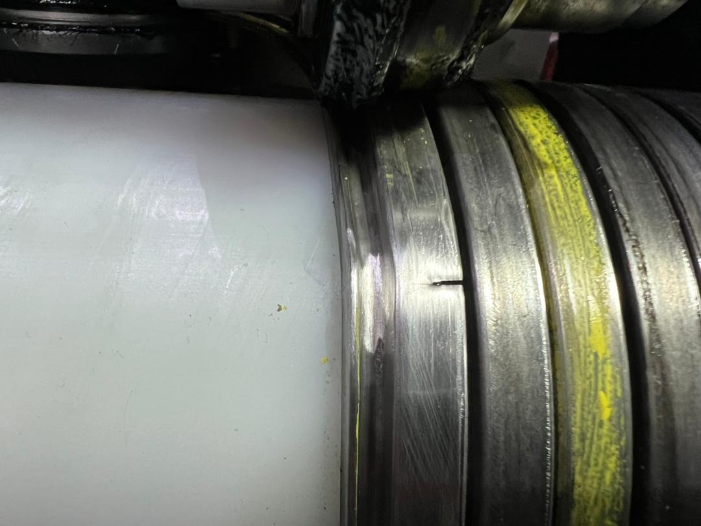
Defect Photo Zeta weld crack at length 277.7m
Figure 1 : Zeta weld broken was detected at length 277.7m on the pipe

Slide 6
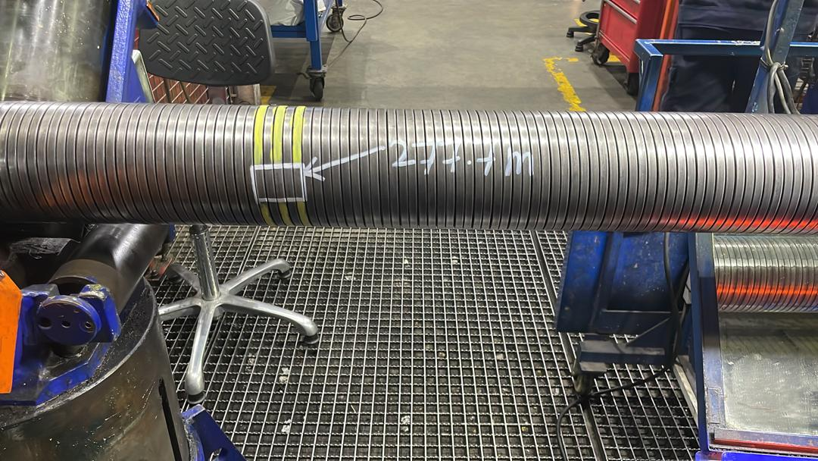
Repair photo at length 277.7m
Figure 2 : The defective weld was rejected according to DP-QCP-08DAQT001. Therefore, un-spiraling was performed to remove the defective weld and replaced it with a new weld from BS13-12 as per DI-IND-MET1075.

Slide 7
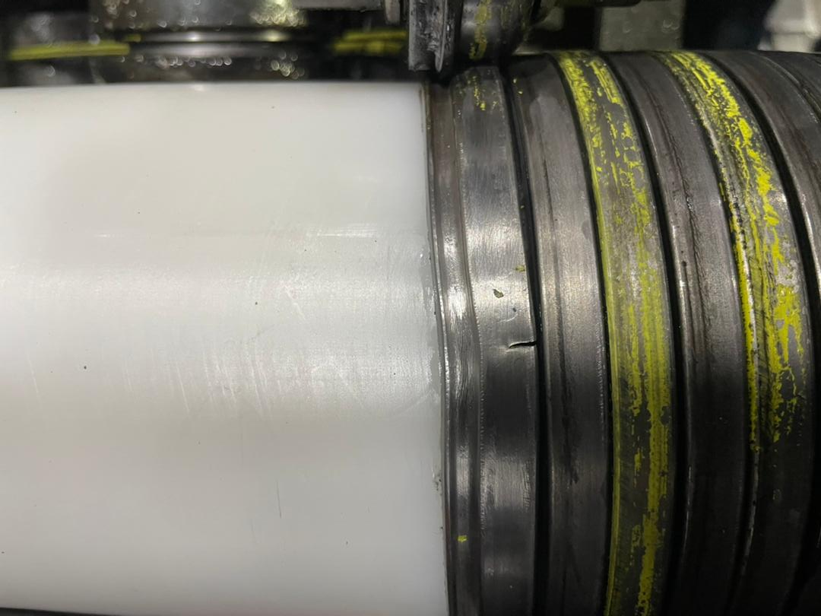
Defect Photo Zeta weld crack at length 620.3m
Figure 3: Zeta weld broken was detected at length 620.3m on the pipe

Slide 8
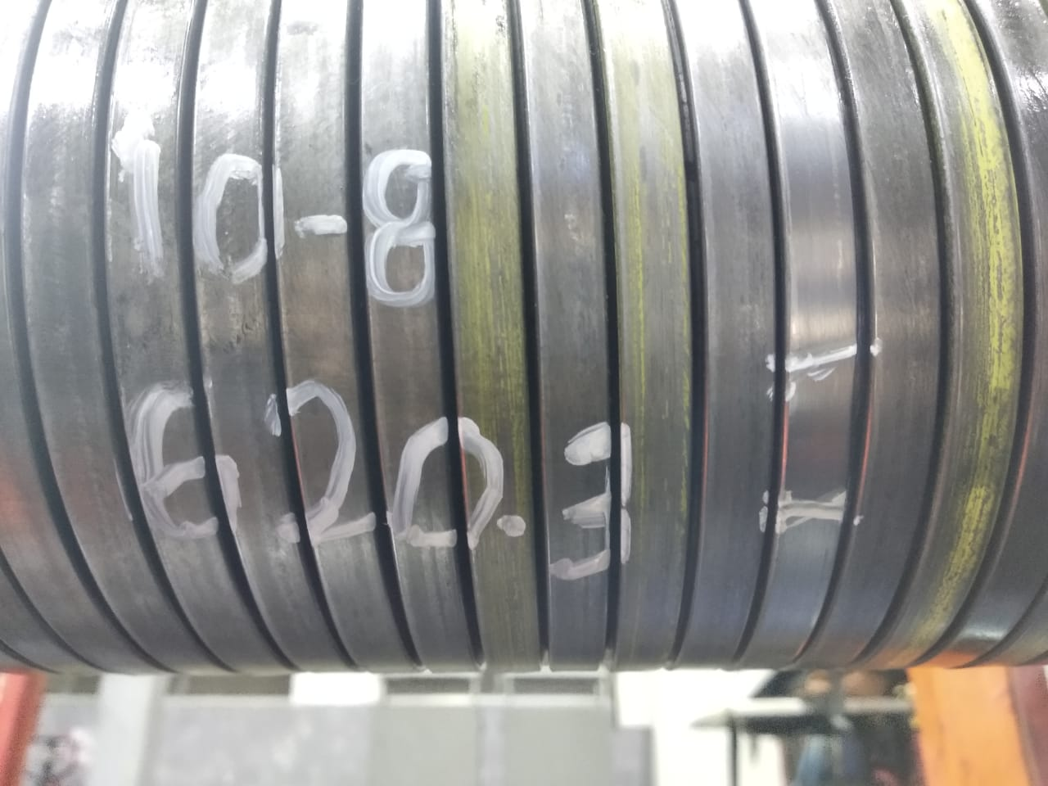
Repair photo at length 620.3m
Figure 4 : The defective weld was rejected according to DP-QCP-08DAQT001. Therefore, un-spiraling was performed to remove the defective weld and replaced it with a new weld from BS13-12 as per DI-IND-MET1075.

Slide 9
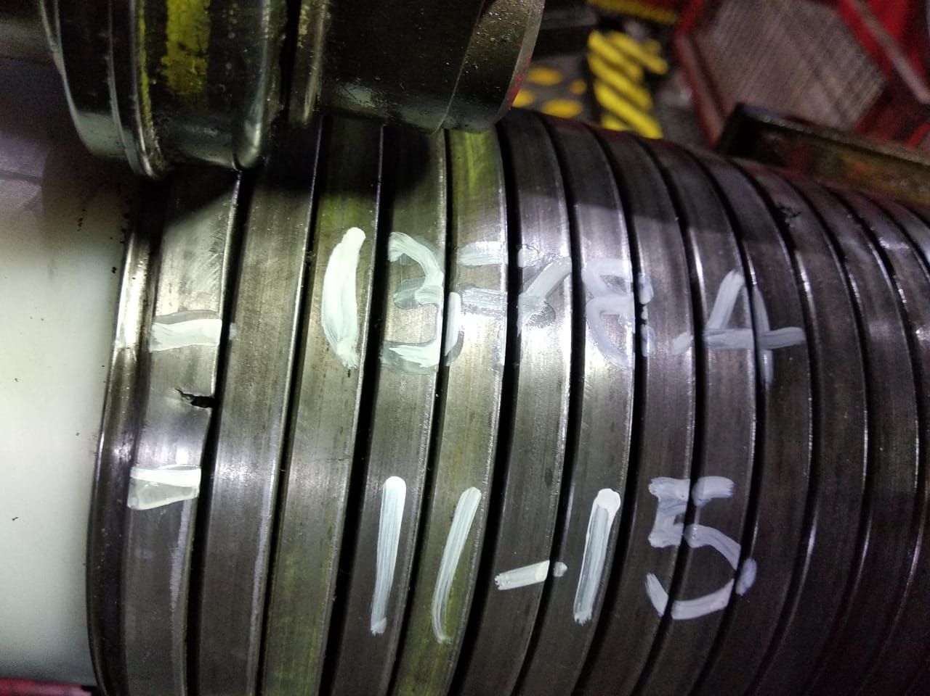
Defect Photo Zeta weld crack at length 1378.4m
Figure 5 : Zeta weld broken was detected at length 1378.4m on the pipe

Slide 10
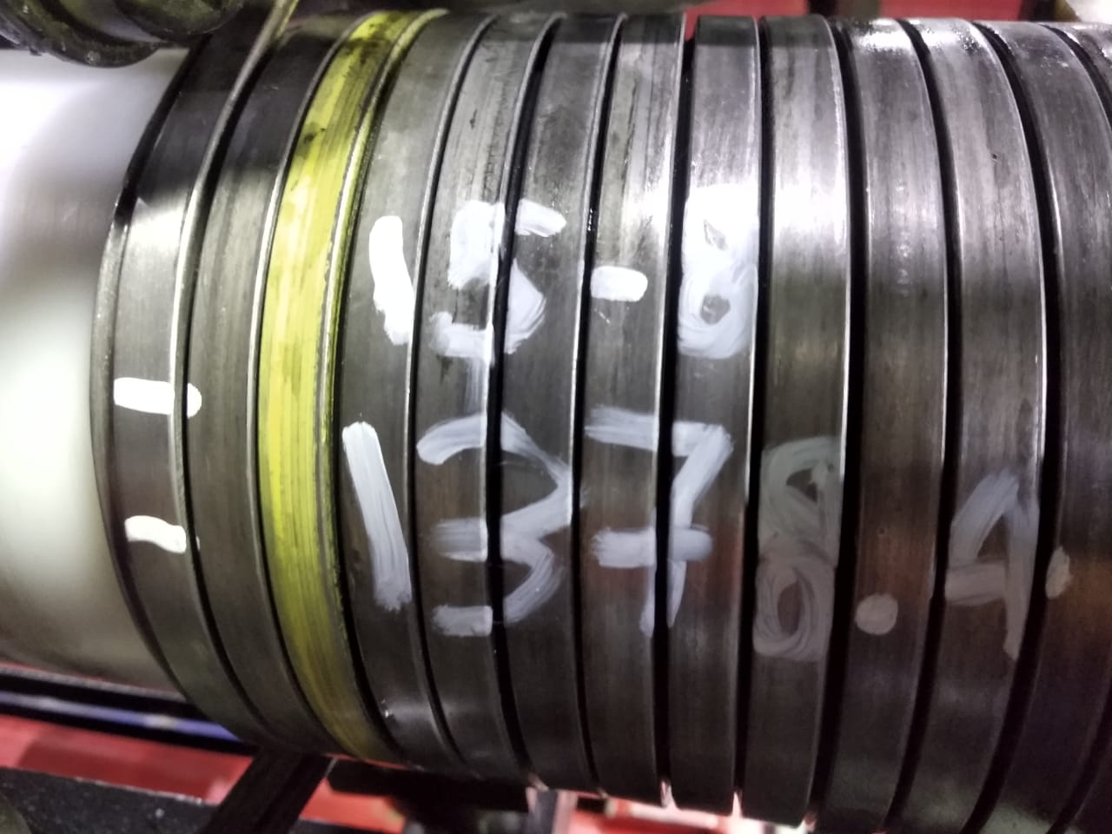
Repair photo at length 1378.4m
Figure 6 : The defective weld was rejected according to DP-QCP-08DAQT001. Therefore, un-spiraling was performed to remove the defective weld and replaced it with a new weld from BS13-12 as per DI-IND-MET1075.

Slide 11
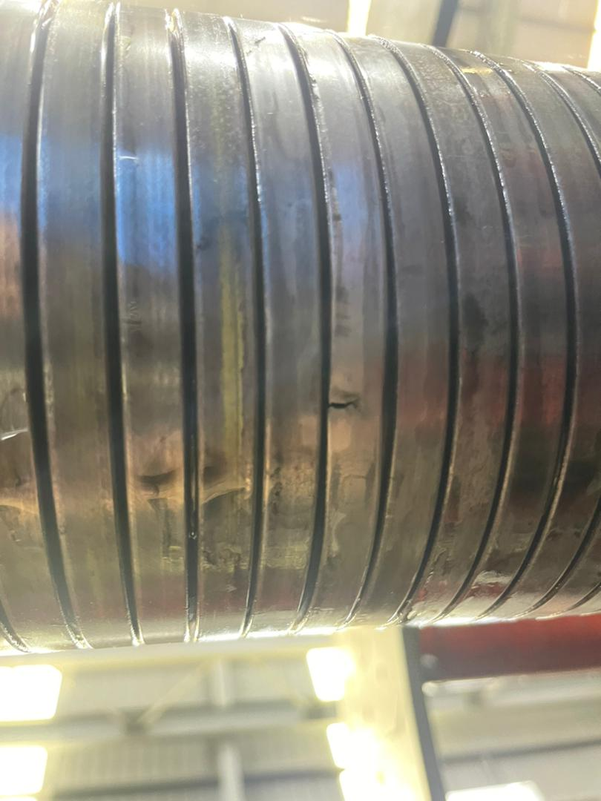
Defect Photo Zeta weld crack at length 2619.8m
Figure 7 : Zeta weld broken was detected at length 2619.8m on the pipe

Slide 12
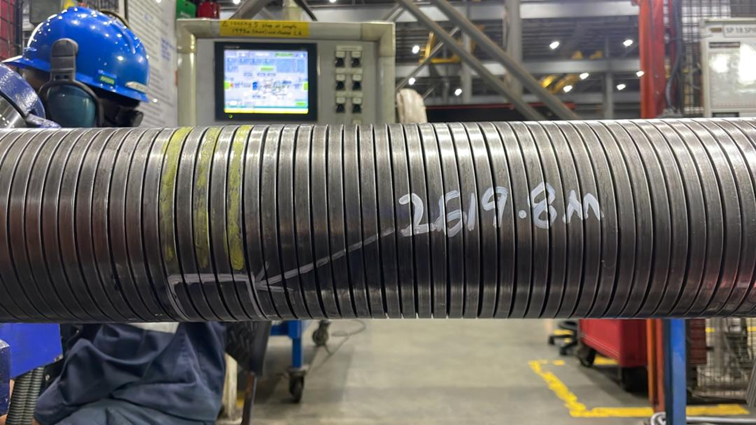
Repair photo at length 2619.8m
Figure 8 : The defective weld was rejected according to DP-QCP-08DAQT001. Therefore, un-spiraling was performed to remove the defective weld and replaced it with a new weld from BS13-12 as per DI-IND-MET1075.

Slide 13

THANK YOU

